Slide 1
COMMUNICABLE DISEASE REPORTING Childcare Facilities
2024-2025

Slide 2
COMMUNICABLE DISEASE REPORTING REQUIREMENTS
Michigan Law requires schools and childcare centers to report specific diseases according to Act No. 368 of the Public Acts of 1978, which states that physicians, laboratories, primary and secondary schools, child daycares, and camps are required to report the occurrence or suspected occurrence of any disease, condition, or infections as identified in the Michigan Department of Health and Human Services (MDHHS) CD rules to your LHD within 24 hours.
It is important for childcare centers to report to their Local Health Department (LHD) for a number of reasons, including:
To identify disease trends, outbreaks, and epidemics
To enable preventative treatment and/or education
To target prevention programs, identify care needs, and allocate resources efficiently
To inform epidemiological practice and research
To evaluate the success of long-term control efforts
To assist with local, state, national, and international disease surveillance efforts

Slide 3
MANAGING COMMUNICABLE DISEASE IN CHILD CARE SETTINGS
Guidance from Child Care Licensing Division and Michigan Department of Health and Human Services
BCAL-PUB-0111, Communicable Diseases (michigan.gov)
Guidelines for identifying, reporting, and responding to an illness, infection, or disease outbreak
COVID-19 Resources
LARA Guidelines for Safe Child Care Operations
https://bit.ly/3puOdMa

Slide 4
QUESTIONS TO ASK PARENTS/GUARDIANS WHEN REPORTING AN ILL CHILD.
Instruct parents / guardians to leave as detailed as
possible message regarding their student’s absence.
Exact nature of illness
Onset of symptoms
Vomiting?
Diarrhea?
Fever?
Sore throat or Cough?
Loss of taste or smell?
Was child seen by doctor?

Slide 5
COMMUNICABLE DISEASE REPORTING WEBSITE
County Specific Sites
For reporting schools and daycares in Barry County
https://www.communicablediseasereporting.com/barry
For reporting schools and daycares in Eaton County
https://www.communicablediseasereporting.com/eaton

Slide 6
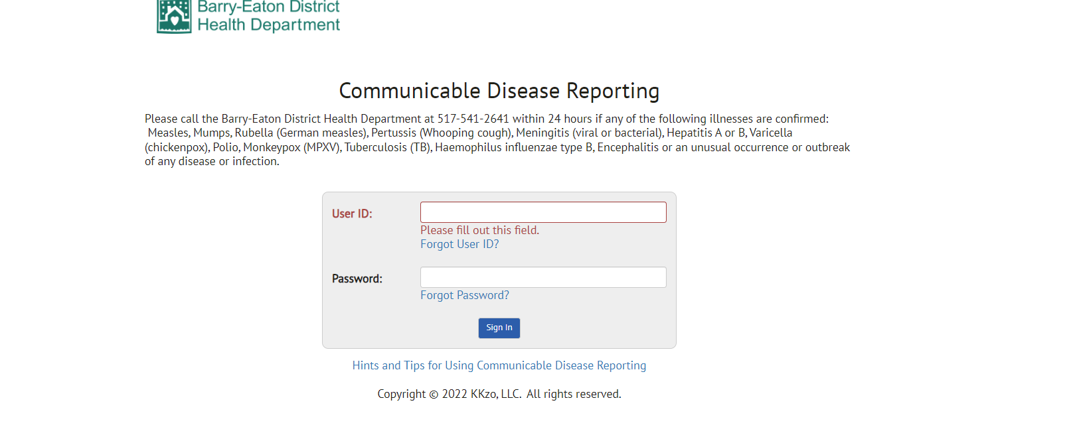
This site can be found at: https://barryeatonhealth.org/schools-communicable-diseases-and-reporting/

Slide 7
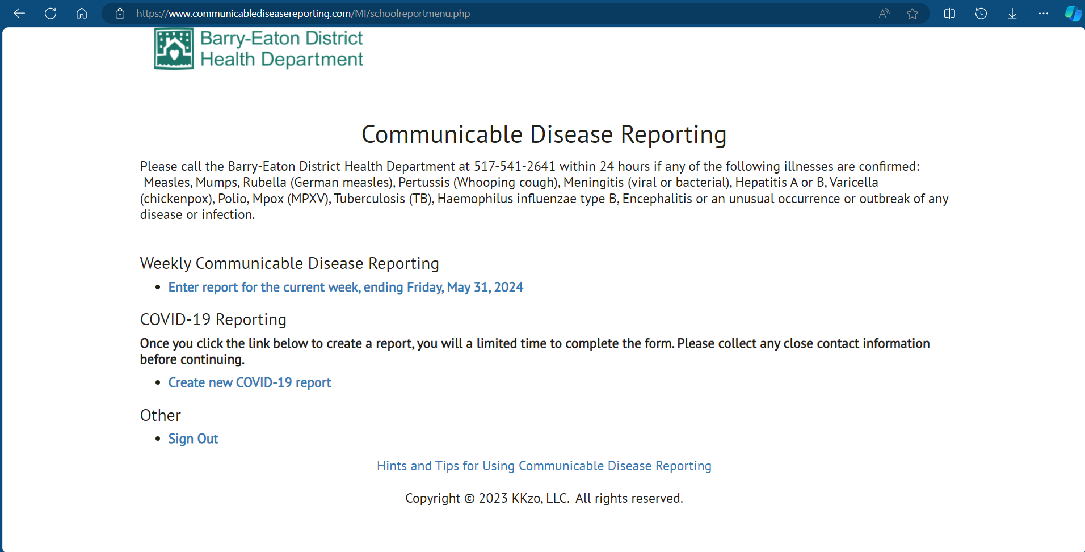

Slide 8
WEEKLY CD REPORTING: SECTION 1
Keep Facility Population Updated!
If there are no illnesses to report
Select the box indicating Nothing to Report
Submit button at bottom of page
YOU ARE DONE!

Slide 9
WEEKLY CD REPORTING: SECTION 2
Immediate Reporting of Serious Communicable Disease or Outbreak
In addition to reporting aggregate and individual cases, call your local Health Department IMMEDIATELY
(517) 541-2641 to report any of the following serious illnesses:
**NOTE: COVID
Measles Mumps Rubella Chickenpox
Pertussis
Haemophilus Influenza Type B Hepatitis
Meningitis
Encephalitis Tuberculosis
Cases will be reported in their own form NOT Section 2
Unusual disease occurrences and outbreaks are also IMMEDIATELY reportable to your LHD. An outbreak is defined as any increase in a certain type of illness. Note: if you are not certain an illness needs to be reported call your health department representative for further assistance.
Call our Case Investigation Line to report outbreaks: (517) 541-2641

Slide 10
WEEKLY CD REPORTING: SECTION 3
Fill in weekly total for each of the sections.
Influenza-like -- fever PLUS sore throat, cough and / or body aches
Gastrointestinal – vomiting and / or diarrhea
Unknown – Parents left no reason, “just not going to be in today” or “sick”

Slide 11
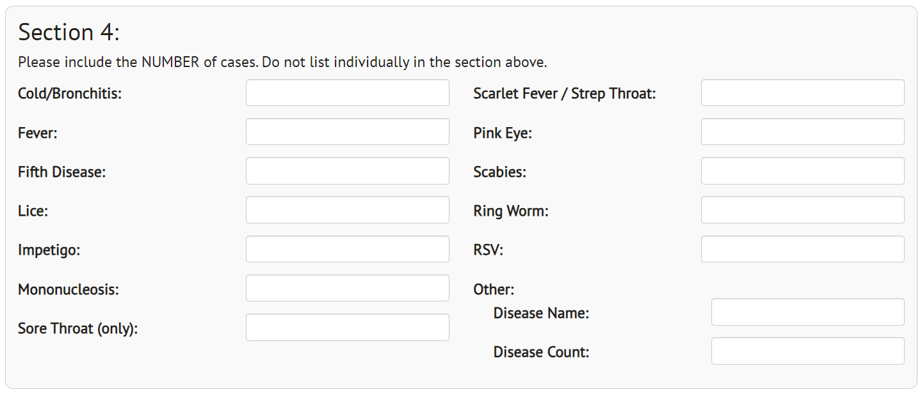
WEEKLY CD REPORTING: SECTION 4
Record specific illness/diagnosis that is reported by parent/guardian
Should not be reported in this section if symptoms fit into section 3
See list provided in section 4 or add to the “other” box provided
List anything reported to you that does not fit into section 3 or is not already specifically listed in this section

Slide 12
WEEKLY CD REPORTING: SECTION 5
Mark this box if facility was closed due to excessive illness related absences
Please contact the Health Department in the event of a necessary closure due to illness
Don’t forget to su bm it your report.
Select submit to send report to the Health Department.

Slide 14
COVID-19 REPORTING
*This is subject to change based on guidance from State and Federal guidelines*
Report COVID-19 cases daily
If a student tests positive through the school’s antigen testing program, their case must be reported within
4 hours using this link: https://newmibridges.michigan.gov/s/isd-antigen-testing-results?language=en_US

Slide 15
COVID-19 REPORTING: CLOSE CONTACTS
If you complete the Close Contacts section of the form, you DO NOT need to email us the contact tracing spreadsheet that was used in previous years.
BEDHD is not currently requiring contact tracing. We may require it depending on MDHHS guidance or
in some outbreak situations.

Slide 16
COVID-19 REPORTING: STAFF & STUDENT GROUPS
Please use Question #9 to list:
What grade the student is in & their teache r ’s nam e or clas sroom #
Bus numbers, sports teams, or other significant groups

Slide 17
DEADLINE TO REPORT
Reports are due by the end of the day every FRIDAY.
Automated reminders are emailed every Friday morning and Monday
morning.
If a holiday falls on a Friday or a Monday and the school will be closed, the Report is due the previous day, or before the holiday break/weekend.
Notes:
Sometimes Amanda sends personal emails Monday/Tuesday as reminders

Slide 18
CONTACT INFORMATION
General Communicable Disease Questions:
(517) 541-2677
schools@bedhd.org
CD Reporting / Website Issues:
(517) 541-2677
schools@bedhd.org
https://barryeatonhealth.org/schools-communicable-diseases-and-reporting/
CD Case Investigation / Outbreak Reporting:
(517) 541-2641

Slide 19
HEARING AND VISION SCREENINGS BEDHD Technicians: Kathylee Brown & Beatriz (Bea) Popp 2024-2025

